Slide 1

Welcome to
Western Culture Course
Professor Meyer

Slide 2
Now introduce yourself!
“Hi, my name is Jiewei and my English name is Sonia. I am studying psychology and my wildest dream is to walk on the moon. I would really like to learn about American religions.”
“Hi, my name is _____ and my English name is _______. I am studying _________ and my wildest dream is to __________. I would really like to learn ______________________.”

Slide 3
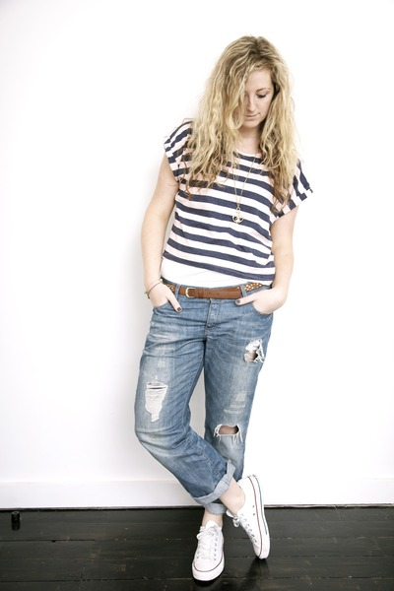
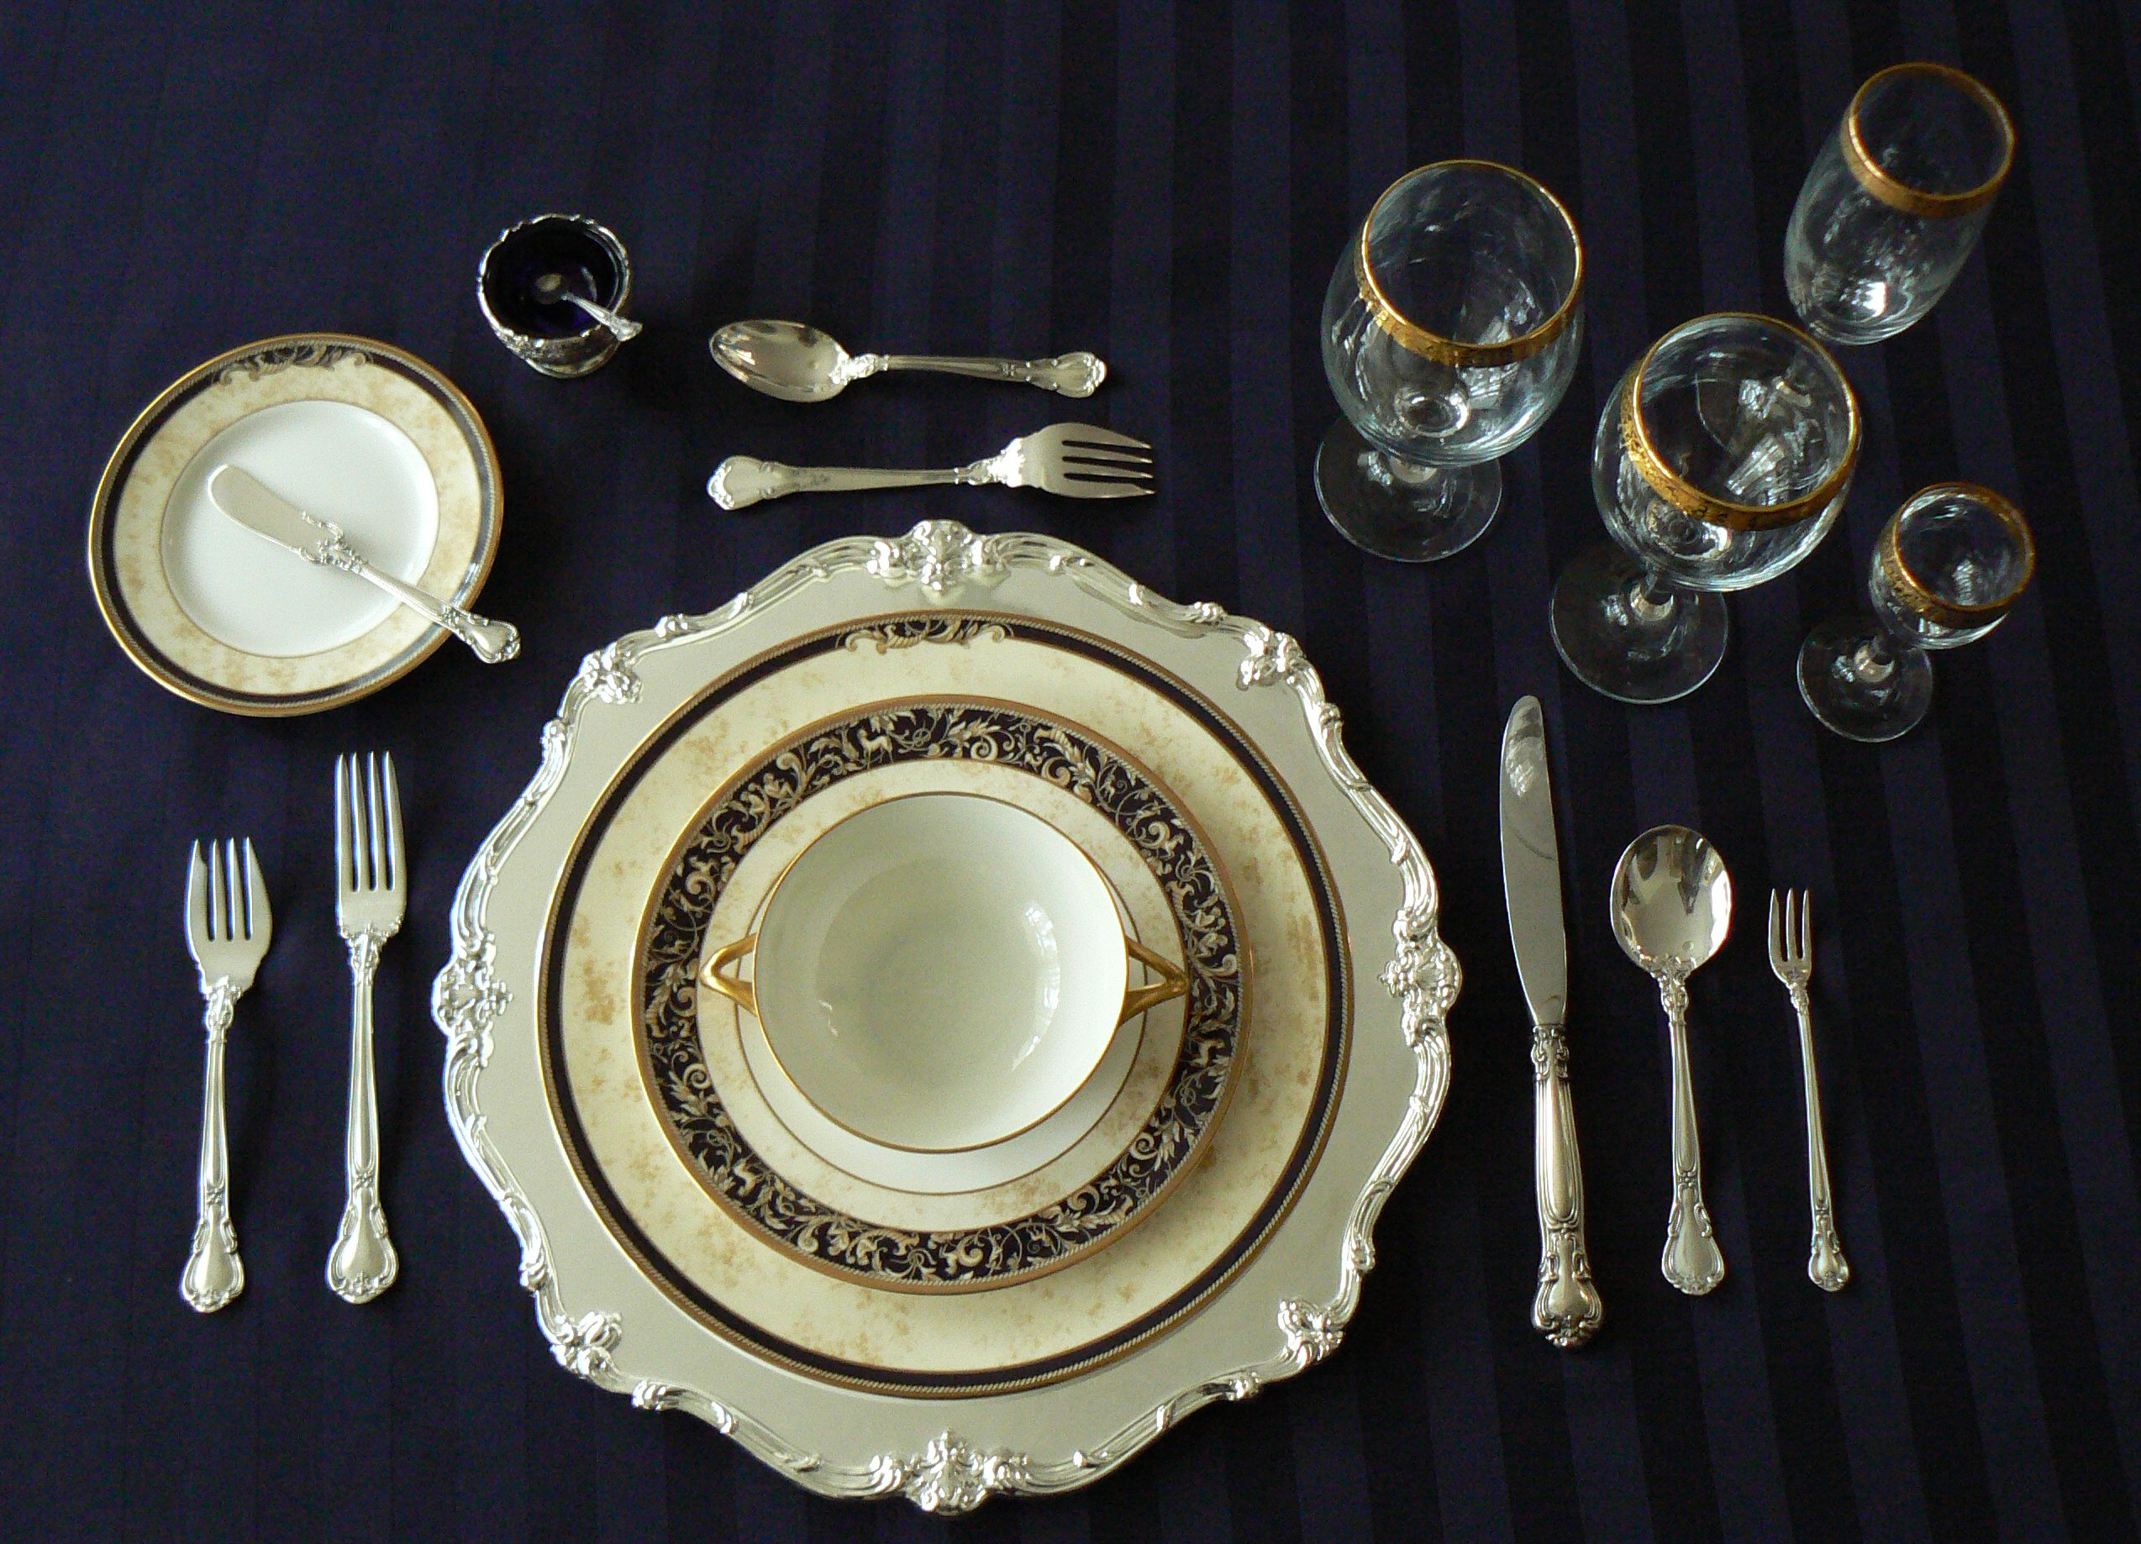
Informal v. Formal
What are characteristics of informality and formality?
What are some informal and
formal situations?

Slide 4
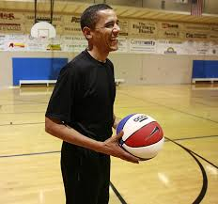
“All men were created equal.”
This American value may not be universally shared.
Informal speech, dress, and body language
  Idiomatic speech and slang
“Regular Joe”
Superficial friendliness
Notes:
High status foreigners do not assume “all men were created equal.”
Informal speech, dress, and body language
Idiomatic speech and slang
Formal speech for public events
Jeans, sandals, etc.
Slouching in chair, leaning against walls
Regular Joe
President Bush/Obama
Part of a group of normal/pleasant people
Superficial friendliness
Informal, egalitarian approach

Slide 5
Idioms
We lost touch.
A picture is worth a thousand words.
Let’s get the ball rolling.
You bet!
Once in a blue moon
Birds of a feather flock together.
Time to hit the books.
You have a one track mind.
… on the wrong side of the tracks.
The cat’s out of the bag.
What goes around comes around.
All that glitters isn't gold.
Rome wasn’t built in a day.

Slide 6
Informal American Relationships
Store clerks/waiter and customer
Student and teacher
Coworkers and boss

Slide 7
Situation: Boss and employee chatting about office barbeque that weekend.
Sue: Hi John, how was your day?
John: Good, I got a lot of work done. You?
Sue: Fantastic. Yeah, I had a good day too.
You going to the work barbeque tomorrow?
John: I wouldn’t miss it! Don’t forget, it’s at 2 pm.
Sue: Got it, I’ll see you there.
John: See ya.

Slide 8
What would you say?
Situation 1: You are checking out at the grocery store and you think the cashier’s hair look nice.
Situation 2: You are at a party and want to introduce yourself to the attractive person standing by the food.
Situation 3: Your friend tells you how worried he is about the upcoming exam.
Situation 4: Your sister just found out that she got into a very good school.

Slide 9
Please remember…
The best way to learn about a culture is to immerse yourself:
  Make foreign friends
  Watch foreign movies
  Read foreign books
You are always welcome to come to me for help with anything.

